Slide 1
NBA Games Predictor
Predicting the winner of every game!

Slide 2
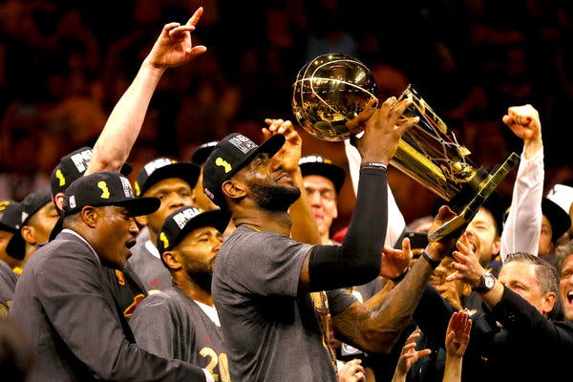


How we’ll do it?
We are going to use decision trees and random forests as machine learning models using the Scikit-learn Python library.

Slide 3
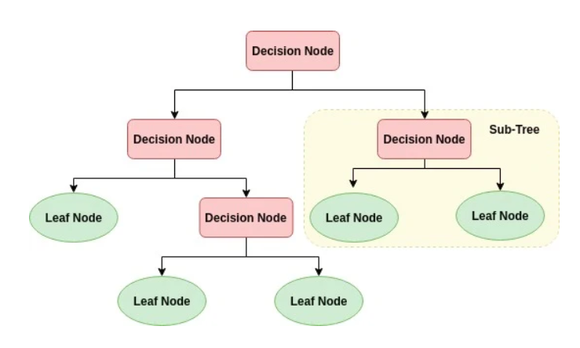
What is a decision tree?

Slide 4
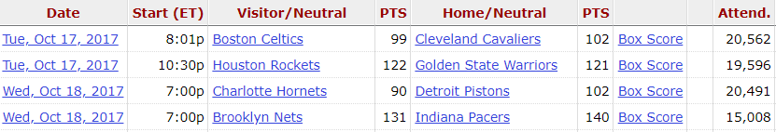
Our data:
Our raw training data will consist of all games from the 2017-2018 regular season. However, we are planning to add more features for each game.
Our test data will consist of all games from the 2018-2019 regular season.

Slide 5
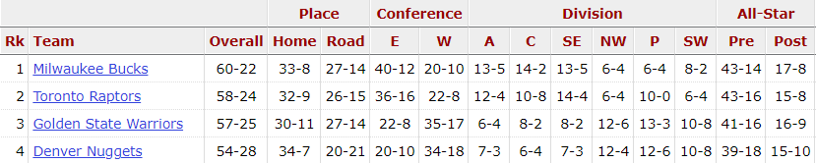
Auxiliary data ideas
We are thinking of using the standings from the previous season for generation of additional features.
For each game – which team ranks higher according to the standings.
Other features that can be added are winning streaks in current season, number of all-star players and more.

